Slide 1
신호 최적화 최종발표
ETRI연구연수생 강민수

Slide 2
Contents
Current Model
3x3Grid Single-Agent Model without Constraints(Depreciated)
3x3Grid Decentralized Model without Constraints(Depreciated)
3x3Grid/Dunsan Decentralized Model with Practical Constraints
Dunsan Decentralized CNN/CNN-reduced Model with Practical Constraints
Upcoming Model
Continuous Action Model with Practical Constraints

Slide 3
3x3Grid Single-Agent/Decentralized Model without Constraints(Depreciated)
Condition (seed fixed)
Generating probability 0.133 (left, right), 0.388 (up, down)
Restricted direction of vehicles(via)/Not restricted direction(no via)
Central agent(n_1_1), 9 Agents(decentralized)
State
The number of inflow vehicles from each inflow edge(left, straight)
Action
Deciding next phase(without an order), every 20s (with all yellow 3 seconds)
Reward
Penalty on Pressure (= inflow-outflow)

Slide 4
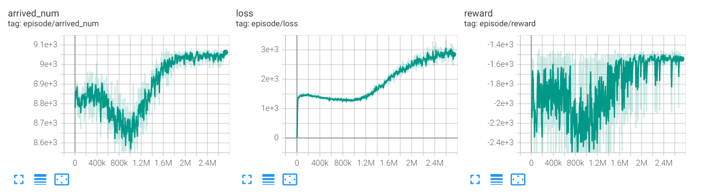
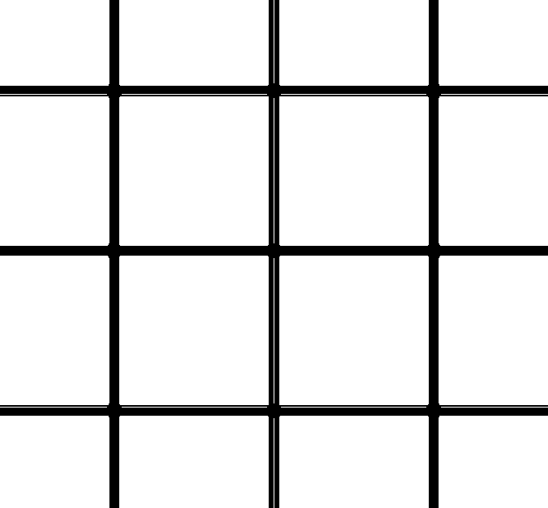
Comparison between Simulation & Single Agent
Simulation 0.133 (left, right), 0.388 (up, down), phase 42(G), 3(Y)
The number of arrived number: 8295 (no via), 8794 (via)
Experiment(Single-Agent Model)
The number of average arrived number: 9060 (no via), 9281 (via)
5~8% Increase
Agent
300m

Slide 5
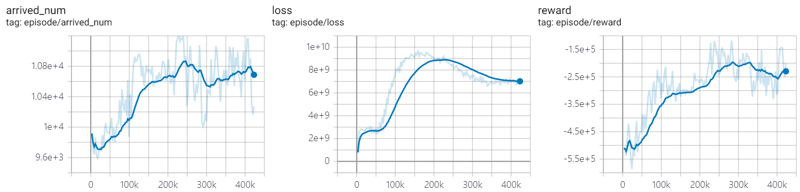
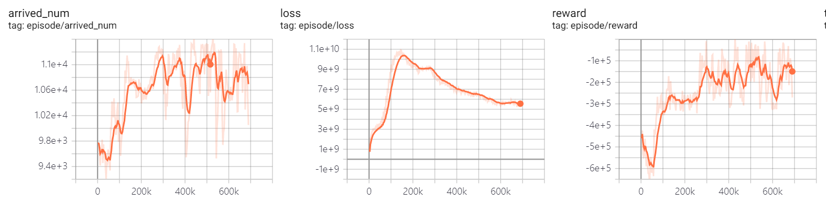
Comparison between Simulation & Decentralized Agents
Simulation 0.133 (left, right), 0.388 (up, down), phase 20(G), 3(y)
The number of arrived number: 9474 (no via), 9765(via)
Experiment(Decentralized Agents Model)
The number of avg arrived number: 10600(no via, blue), 10800 (via, orange)
10~11% Increase

Slide 6
3x3Grid/Dunsan Decentralized Model with Practical Constraints
Condition(seed fixed)
Random routing vehicle generation (period 0.8), scale 1.1 (by randomTrips.py)
9 Decentralized Agents(No offsets, Update Asynchronously)
4 Phases(Vertical/Horizontal straight and left) 37s each, followed by all yellow 3s
Model applied min/max duration(28s,49s) and phase period(160s)
State
The number of inflow vehicles from each inflow edge(left, straight)
Update phase demand(# of vehicles inflow) from end of phase period

Slide 7
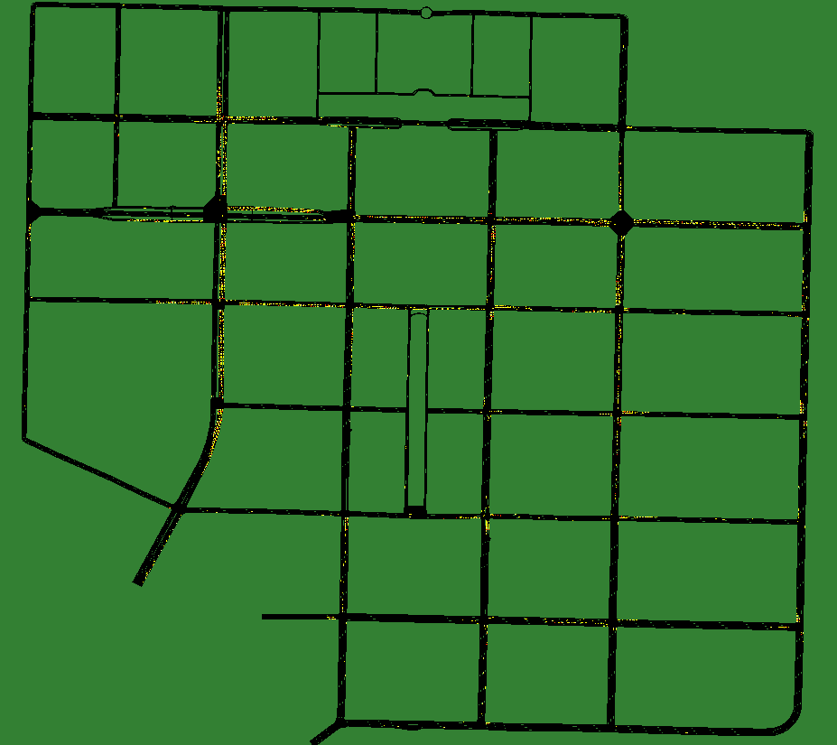
3x3Grid/Dunsan Decentralized Model with Practical Constraints
Turn off the Signal
Condition(seed fixed)
Real Demand(0-3[scaled 2times],7-10am[scaled 0.7 times])
9 Decentralized Agents(Update asynchronously by offsets)
Using Each designated phase rule in xml file
Model learned from only first 3600 steps
State
The number of inflow vehicles from each edge(left, straight)
Update demand(# of vehicles inflow) from end of phase period
Controlling Sector

Slide 8
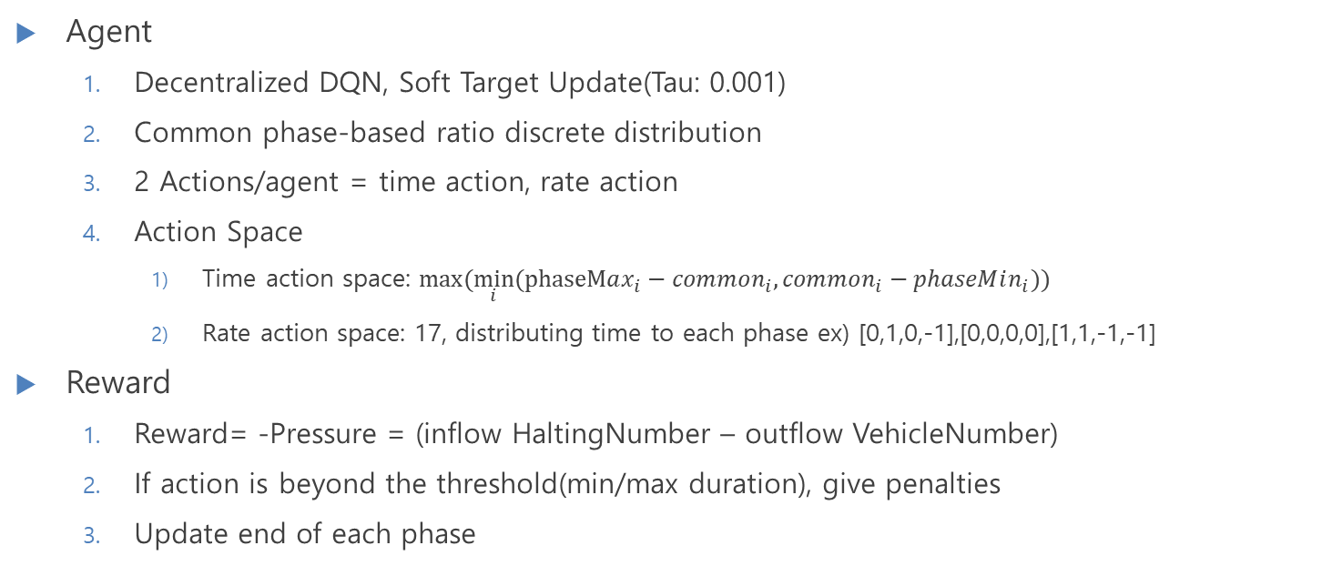
3x3Grid/Dunsan Decentralized Model with Practical Constraints
Dunsan Rate Action
Agent
Decentralized DQN, Soft Target Update(Tau: 0.001)
Common phase-based ratio discrete distribution
2 Actions/agent = time action, rate action
Action Space
Time action space: $max⁡(\min_{i}⁡(phaseMax_{i}−common_{i},common_{i}−phaseMin_{i}))$
Rate action space: 17, distributing time to each phase ex) [0,1,0,-1],[0,0,0,0],[1,1,-1,-1]
Reward
Reward= -Pressure = (inflow HaltingNumber – outflow VehicleNumber)
If action is beyond the threshold(min/max duration), give penalties
Update end of each phase
# of phase | Action space
2 | 2
3 | 3C2*2+1
4 | 4C2*2+4C4*4+1
5 | 5C2*2+5C4*4+1

Slide 9




Decentralized Model with Practical Constraints
Action: $a_{t}^{i}$
RL Modeling
Agent
Agent
Agent
Agent
Environment
Traci
State:$s_{t}$
Neural Net (shared params)
Update Mask
$$i$$
TL_Period
Reward: $r_{t}^{i}$

Slide 10
Decentralized Model with Practical Constraints
# of phase | Action space
2 | 2
3 | 7
4 | (4C2)*2+4+1
5 | 5C2+5C4+1
DNN Modeling
Neural Net (Shared Params)
Left Straight
argmaxQ = rate action
Vehicle Info from Traci
Rate Q Network
argmaxQ = time action
Intersection Traffic Demand
Super Q Network
Time Q Network
Concatenated
Traffic Demand
Other Agents
Inflow Demand

Slide 11
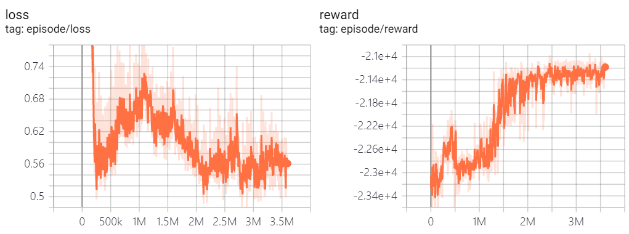
Decentralized Model with Practical Constraints
3x3 grid
9 Agents
Random Routing Generation → 1 period, 1.5 scaled
Dunsan
11 Agents
Real Demand based training → 0-3am, 2.0 scaled
Avg Value | Simulation | Decentralized
Travel Time (per edge) | 61.0s | Not converged
Velocity | 3.43m/s | -
Waiting Time (whole trip) | 40.2s/veh | -
Avg Value | Simulation | Decentralized
Travel Time (per edge) | 13.82s | 14.52
Velocity | 5.93m/s | 5.769m/s
Waiting Time (whole trip) | 495.5s/veh | 534.1s/veh
Arrived Num | 10951 | 10863

Slide 12
Dunsan Decentralized CNN/CNN-reduced Model with Practical Constraints
CNN based Decentralized Model
CNN: Convolution Neural Network
Feature extraction in selected region → Apply to intersection information
Advantage: less parameters than Fully Connected Network → Lightweighting
CNN based Model (Feature Extraction) 1000epochs
Current Channel: 8 (zero-padded demand of vehicles from inflow edge)
After CNN, the number of channel: 16
Learning Time: 8h 11m(0-3am), 30h(7-10am)
CNN based Lightweight Model
By using Conv1d, dimensionality reduced to 1 channel with feature
Learning Time: 6h 10m, 26h(7-10am)

Slide 13
Dunsan Decentralized CNN/CNN-reduced Model with Practical Constraints
CNN based model(Single Agent based Model)
Neural Net (Shared Params)
Left Demand Straight Demand
argmaxQ = rate action
Vehicle Info from Traci
Conv1d
Rate Q Network
argmaxQ = time action
Intersection Traffic Demand
8 Activation Maps/
1 Activation Map
Super Q Network
Time Q Network
Other Agents
Concatenated
Traffic Demand
Other Agents
Inflow Demand (Zero Padded)

Slide 14
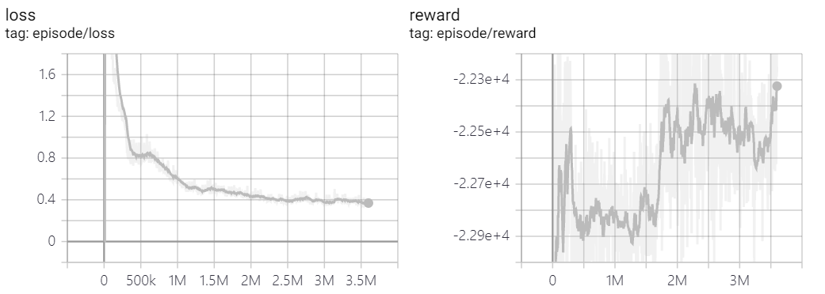
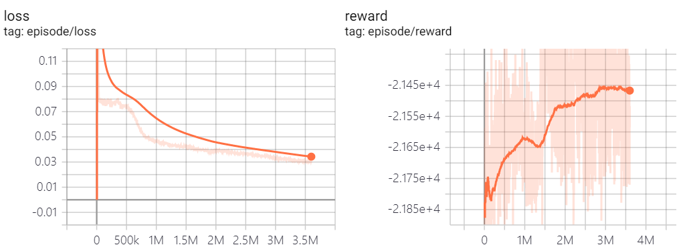
Analysis of Decentralized CNN-reduced Model
CNN Model(0to3am)
8 feature → Checking demand change
CNN-reduced Model(0to3am)
1 feature → Current traffic info
Avg Value(interest edges) | Simulation | Decentralized-CNN | Decentralized-CNN-reduced
Travel Time (per edge) | 33.8s | 47.5s | 42.4s
Avg Velocity(edge veh) | 5.99m/s | 5.52m/s | 5.82m/s
Waiting Time (during whole trip) | 165.1s/edg | 210s/edg | 175.5s/edg
Arrived Num (all edge) | 11167 | 11022 (02-19_09-29-17) | 11114 (02-23_09-36-26)
Travel Time: mean value of getTraveltime for all steps that are filtered less than two tl periods
Avg Velocity: average velocity from edge that defined to control by model

Slide 15
Analysis of Decentralized CNN-reduced Model
Avoiding Overfitting(Validation)
Add Dropout Layer between fully connected layer in super Q Network
Apply peak demand(7-10am) to the model learned from free demand(0-3am)
Conclusion: For wide coverage, strengthen performance by dropout layer
Avg Value | Simulation | Before adding dropout | After adding dropout
Travel Time (per edge) | 43.546s | 54.716s | 44.5s
Velocity(edge veh) | 5.413m/s | 5.187m/s | 5.46m/s
Waiting Time (count all veh in edg) | 208.95s/edg | 287.42s/edg | 219.54s/edg
Arrived Num | 12111 | 11873 | 12175(02-24_15-20-23)

Slide 16
Analysis of Decentralized CNN-reduced Model
Practical Constraints without minimum of duration condition
Removing penalty in action that is less/more than min/maximum length of duration
Purpose: Verifying whether regulations lead traffic jam or not
Learning process and Reward comparison
Conclusion: 1) Current signal is incomplete (scope to improve more) 2) Hard to learn model with constraint 3) Arbitrary Penalty -> Not converge
 | Learning with Constraint | Learning without Constraint
Learning Time | 6h 14m | 5h 56m
Avg converge reward | 9.2e-3(02-25_08-50-45,not converge yet) | -8.8e-3(02-24_15-20-23)
Avg velocity(sim in 7-10) | 5.40m/s | 5.46m/s

Slide 17
Final Model
Decentralized CNN-reduced Deep Reinforcement Learning model
Hyperparameters: tau 0.001, gamma 0.99, lr 1e-4, eps 0.8, both decay_rate 0.99, batch 64
Vehicle Info from Traci
Neural Net (Shared Params)
Left Demand Straight Demand
argmaxQ = rate action
Conv1d
(1,)
Rate Q Network
(36,24,rate_action)
argmaxQ = time action
Intersection Traffic Demand
1 Activation Map
(num_phase,4,1)
Super Q Network
Linear(Num_agent,48,36)
Dropout(0.4,0.3)
Time Q Network
(36,24,time_action)
Other Agents
Inflow Demand (Zero Padded)
Concatenated
Traffic Demand
Other Agents

Slide 18
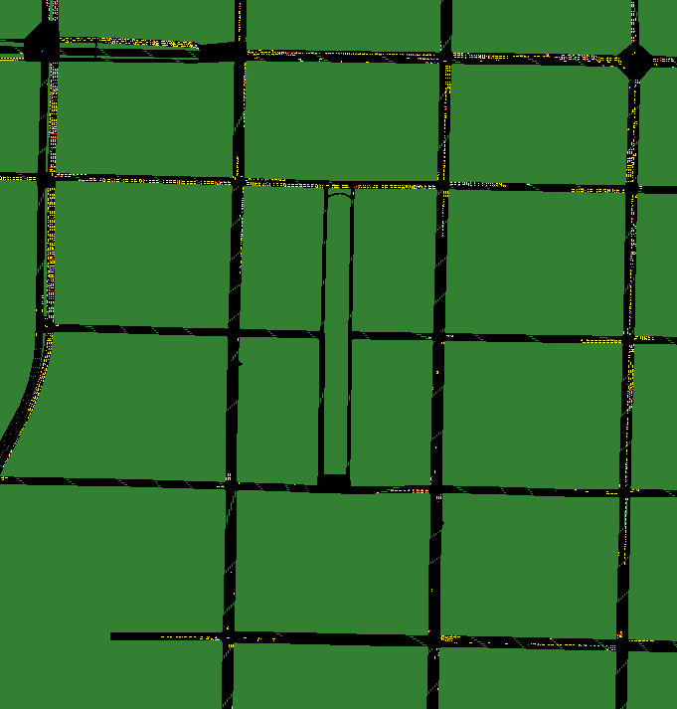
Reason for failing experiment
RL Controlling Sector
Generated Actual data biased for fixed time signal control
Congested road conditions not being reflected by scaled data
Using 7-10am demand instead of 0-3am
Trade off between learning time(x3 in 7-10) and performance
Hard to improve the performance due to fixed offset value
Due to lack of other traffic light control, lead RL traffic lights lower performance
No convergence due to arbitrary penalty in case of exceeding threshold(min/max duration)
In SUMO, road deletions due to absence of pocket(left turn) lead unintended traffic jam
Traffic Jam Sector

Slide 19


Continuous Action Model with Practical Constraints
DDPG based Model
Current action space: Time, Rate → Phase length (for each phase)
Splitting rest of time (Total TL period – sum of min durations for each phase)
Phase distribution by the results of softmax($a_{i}$)
Sum of results by softmax function = 1 → Easy to distribute length of phase
DDPG
DDPG target
Action
Update, Approx.
Actor
Actor
Soft Update
$$a_{i}$$
Critic
Critic
Min Duration
State
Environment

Slide 20
Thank you

